Slide 1

BVS PE Expectations 25/26
Welcome Back!

Slide 2
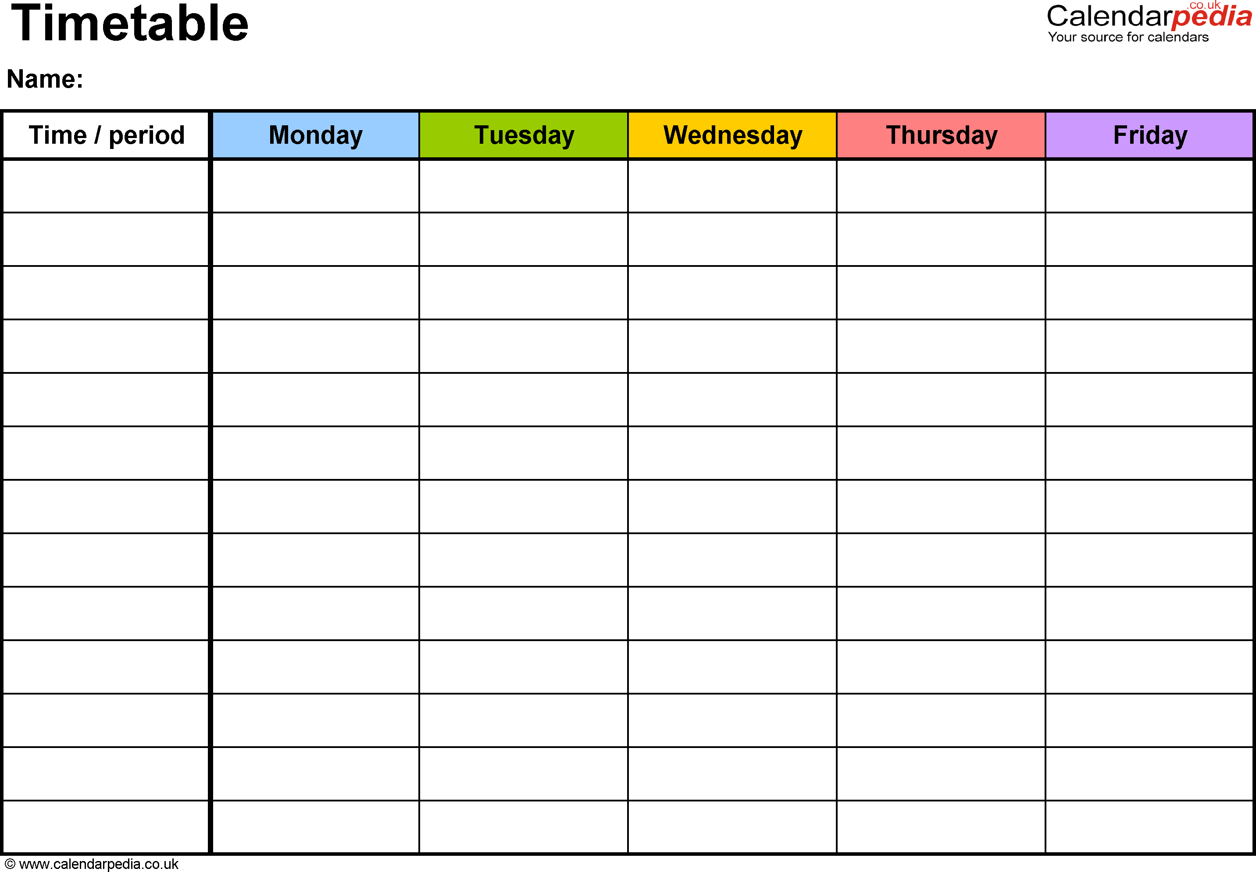
PE Days 25/26
Year 3 / Wednesday / Friday
Year 4 / Monday / Wednesday
Year 5 / Tuesday / Wednesday
Year 6 / Tuesday / Thursday

Slide 3
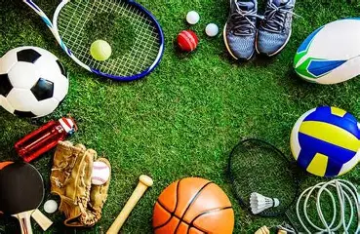
What to Expect
Year 3 / Multi Skills / Netball / Hockey / Athletics / Dance / Gymnastics / Tennis / Cricket / OAA
Year 4 / Basketball / Football / Athletics / Swimming/ Dance / Gymnastics / Tennis / OAA / Rounders
Year 5 / Netball / Hockey / Athletics / Dance / Gymnastics / Tennis / OAA / Rounders
Year 6 / Basketball / Football / Athletics / Dance / Gymnastics / Tennis / OAA / Rounders

Slide 4
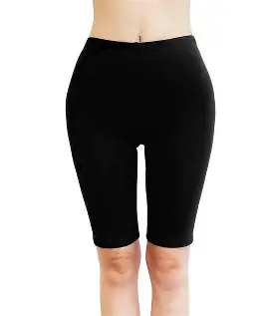
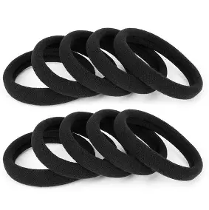
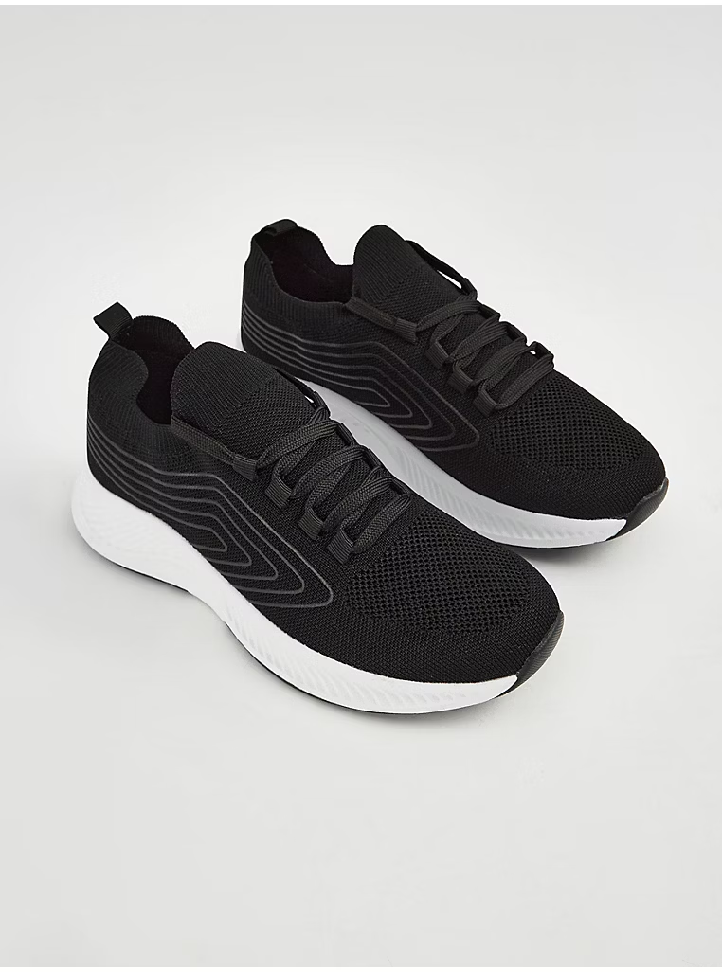
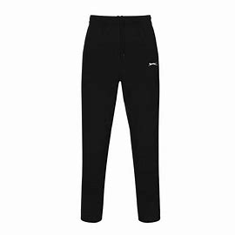
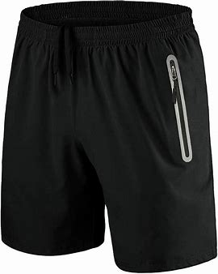
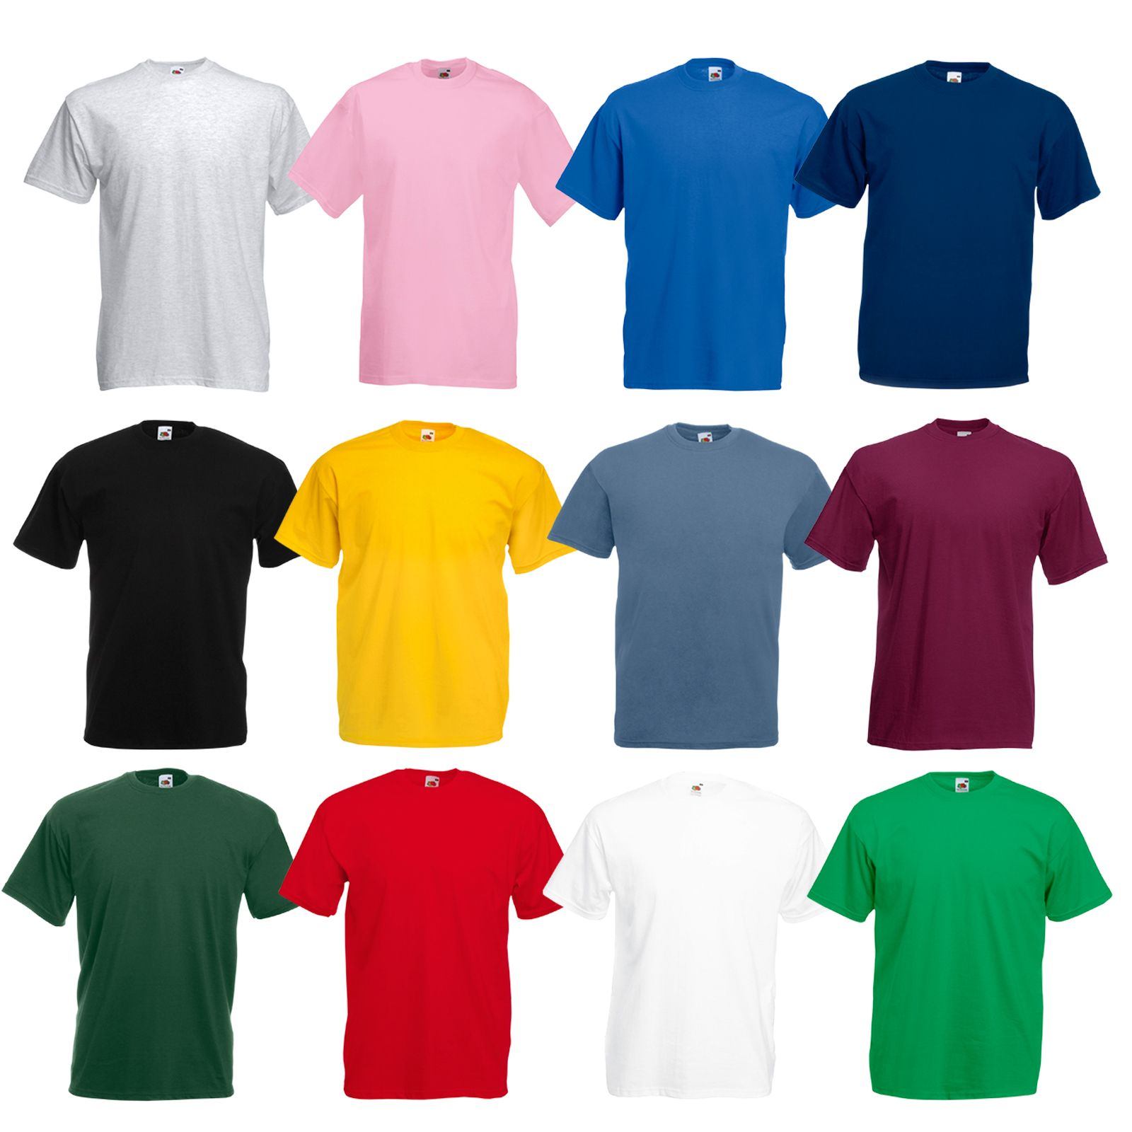
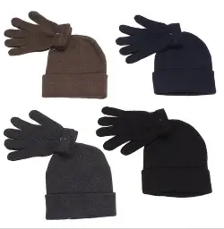
BVS PE Kit Do’s
Joggers/Leggings
Shorts (must be knee length)
Appropriate and comfortable trainers
Shoulder length hair tied up
Plain house coloured or white/BVS blue t-shirt (no collars)
House coloured or plain Sweatshirts/Jumpers
Weather appropriate clothing

Slide 5
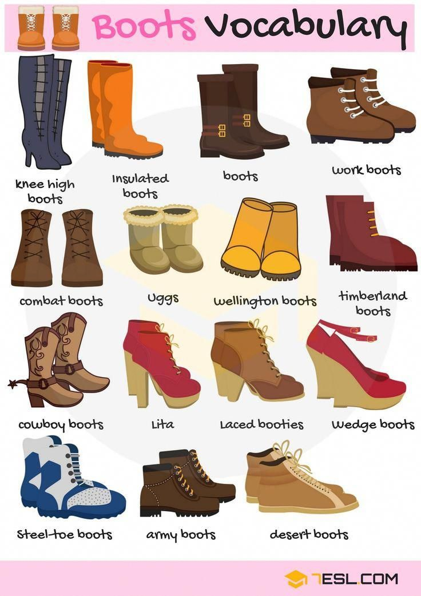
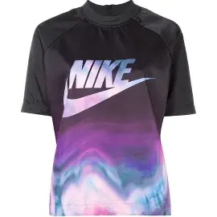
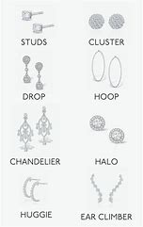
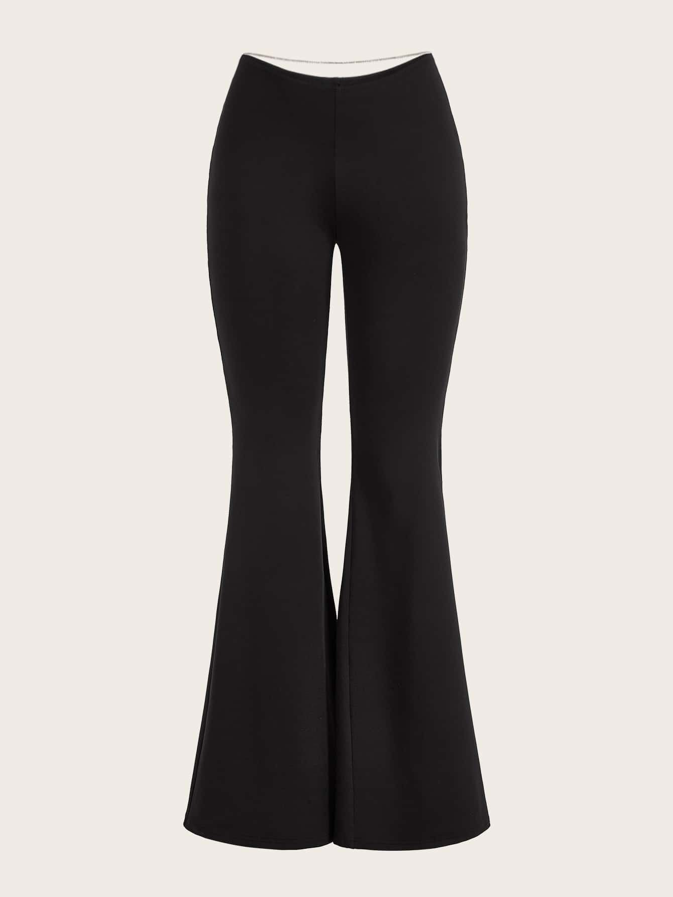
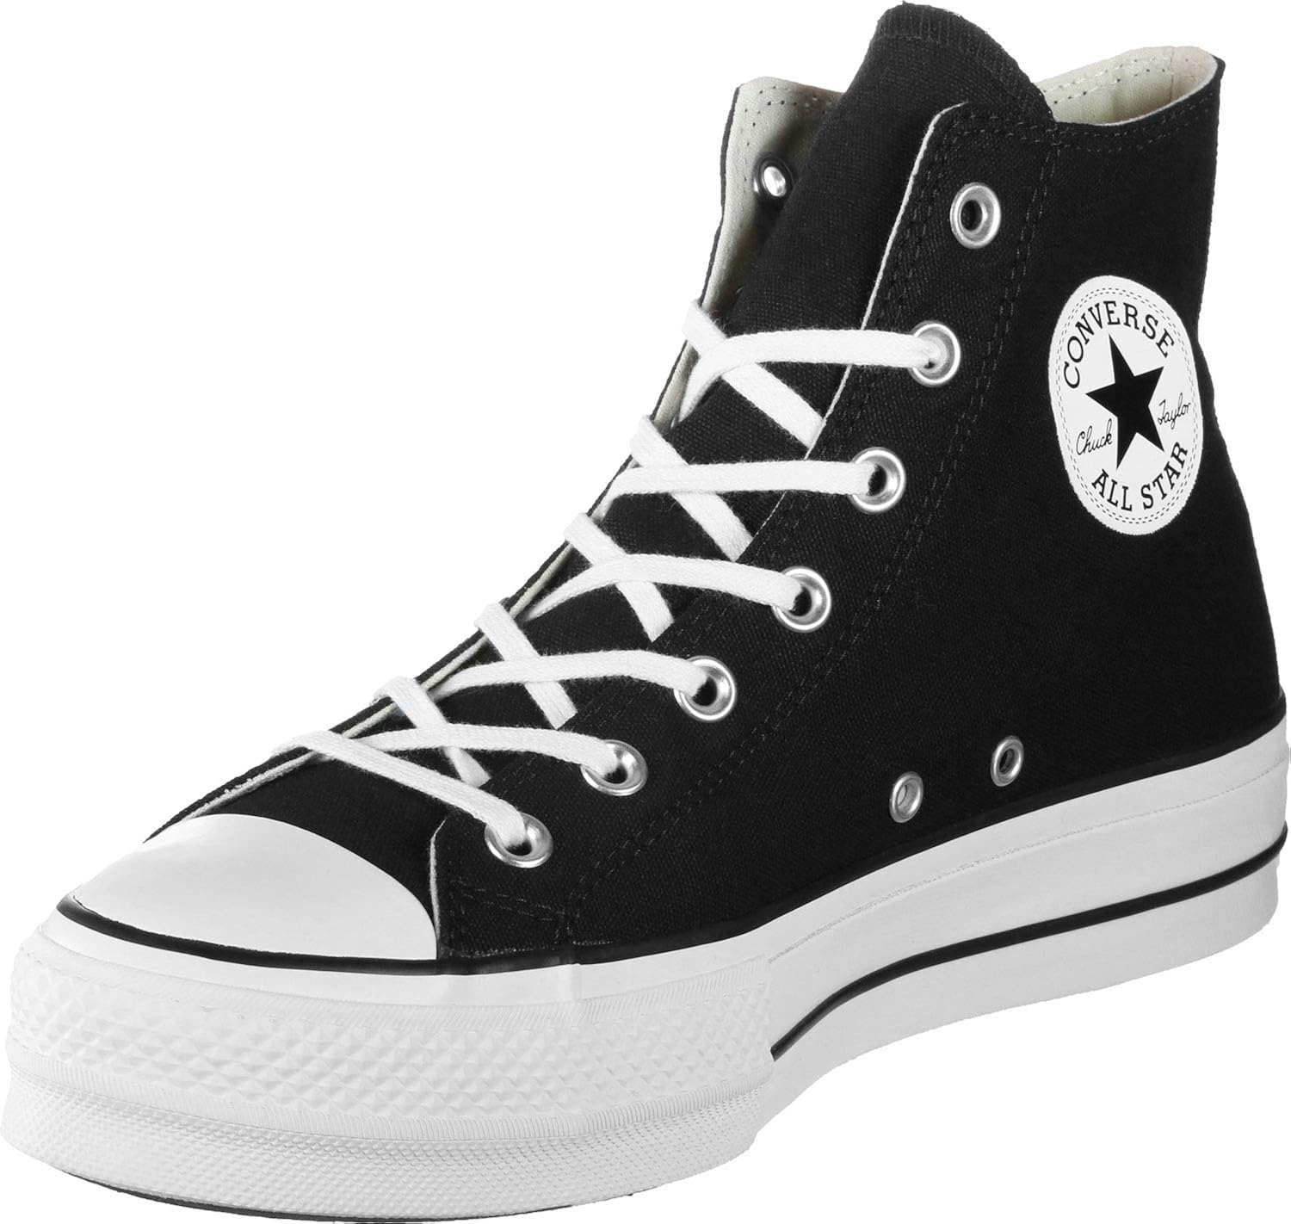
BVS PE Kit Don’ts
Heavily Branded or patterned Clothing
Flared trousers
Shorts above knee length
Boots or canvas trainers
School Shoes
Hoodies
Jewellery (including watches)

