Slide 1

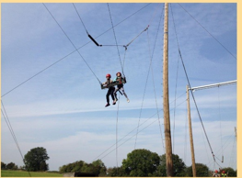


Year 5 and Year 6 residential
Wednesday 22nd – Friday 24th October 2025
Parent’s information evening

Slide 2
Staff attending the residential
Mrs Brodie-Shaw (Year 4 teacher and visit lead)
Mrs Carlin (Year 6 teacher)
Mrs Branch (SENCO, DSL and SLT)
Mr O’Connor (Sports Coach)
Miss Clarke (Office admin/first aid lead)
Miss Allen (LSA/first aider)
Miss Herbert (LSA)

Slide 3
Our itinerary
Wednesday
The children will need to come into school via the hall at 9.30 am or they can arrive at normal school time.
The children will need to bring all of their belongings into the hall.
Please ensure your child brings in a packed lunch, including a reusable water bottle, from home on this day. If your child has a free school meal, we will provide lunch.
Please do not pack midnight snacks or sweets/chocolate for the coach journeys.
Approximately 10:00am coach will depart BVS.
Children will need a substantial snack to eat before they leave school.
Arrive at Caythorpe at approximately 12:15pm
Children will eat their lunch when we arrive and get settled.
Our first activity starts at 2.15 and our second activity at 3.55.
Dinner approx. 6pm
Evening Activity (7.30pm – 8.30pm)

Slide 4
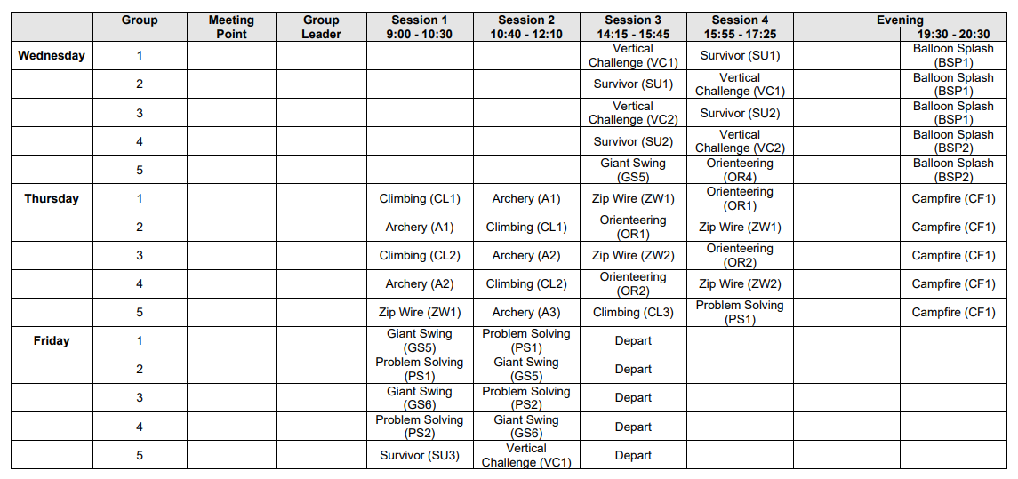
Schedule for the week

Slide 5

Explore the PGL website to find out more, including a 360 tour and a break down of each activity.
https://www.pgl.co.uk/en-gb/international-agents/centres/caythorpe-court?cid=109?ci=Agent3
You will find a list of activities that can be completed, along with pictures of the buildings, accommodation and activities.
https://schoolsandgroups.pgl.co.uk/centres/caythorpe-court/

Slide 6
Friday
The children will complete their final two activity sessions on Friday morning
Session 1 (9:00 – 10:30)
Session 2 (10:40 – 12:10)
The children will be eat lunch at PGL before we depart.
Depart Caythorpe at approximately 14:00.
Arrive back at school at approximately 16:20. Please do not park outside the school as there will be a coach needing to park up and the children need to be able to disembark safely. If someone other than a parent is collecting please let Mrs Brodie-Shaw know.

Slide 7
What to bring:
Freshly laundered Sleeping Bag & Pillow with Pillowcase
A reusable drink bottle
Toiletries etc (please note deodorants must be roll-on, no aerosols)
Waterproof clothing
Large plastic bag for dirty clothes
Bath towels
Useful notes:
No jewellery (including piercings), except for stud earrings
Please name all clothing
Denim jeans are not ideal for outdoor use

Slide 8

Mobile phones
Children will not be allowed to take mobile phones to the residential. From experience, we have found that mobile phones have been an inconvenience and can get in the way of the fun they will have.

Slide 9

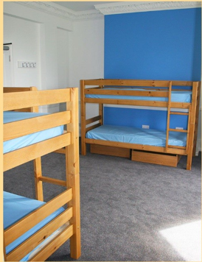
Evenings at Caythorpe
Evening activities will take place each evening from 19:30 – 20:30
The children will be in bed at approximately 21:30. The site will be locked and there are night staff also on patrol.

Slide 10
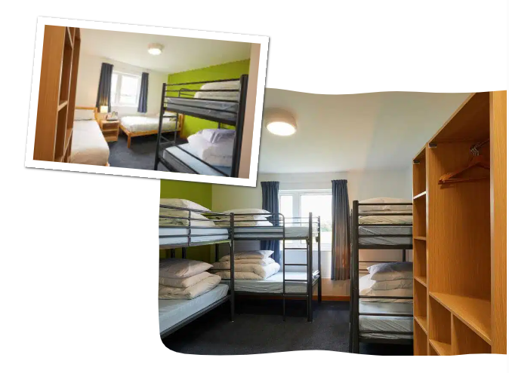
Dormitories
The rooms are in groups of 4 or groups of 6. Each bedroom has an ensuite, including a toilet and a shower. We are spread over two floors.
Your children have all chosen 5 friends they would like to share with - we will try to accommodate the children’s preferences but we can only promise them at least one friend.
They will find out who they are with when we arrive.

Slide 11
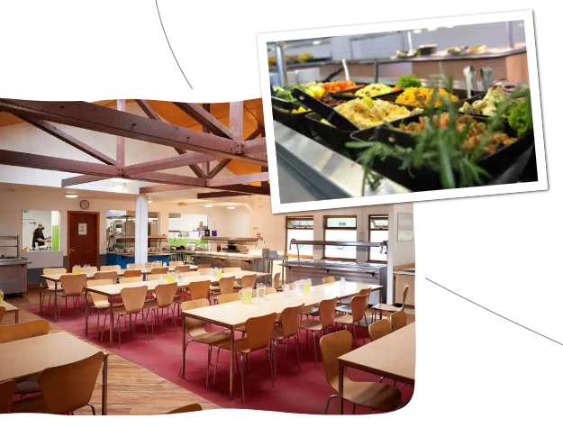
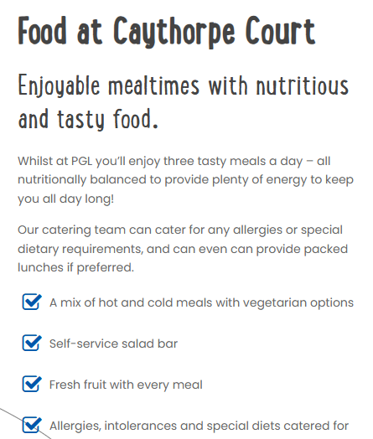
Mealtimes

Slide 12
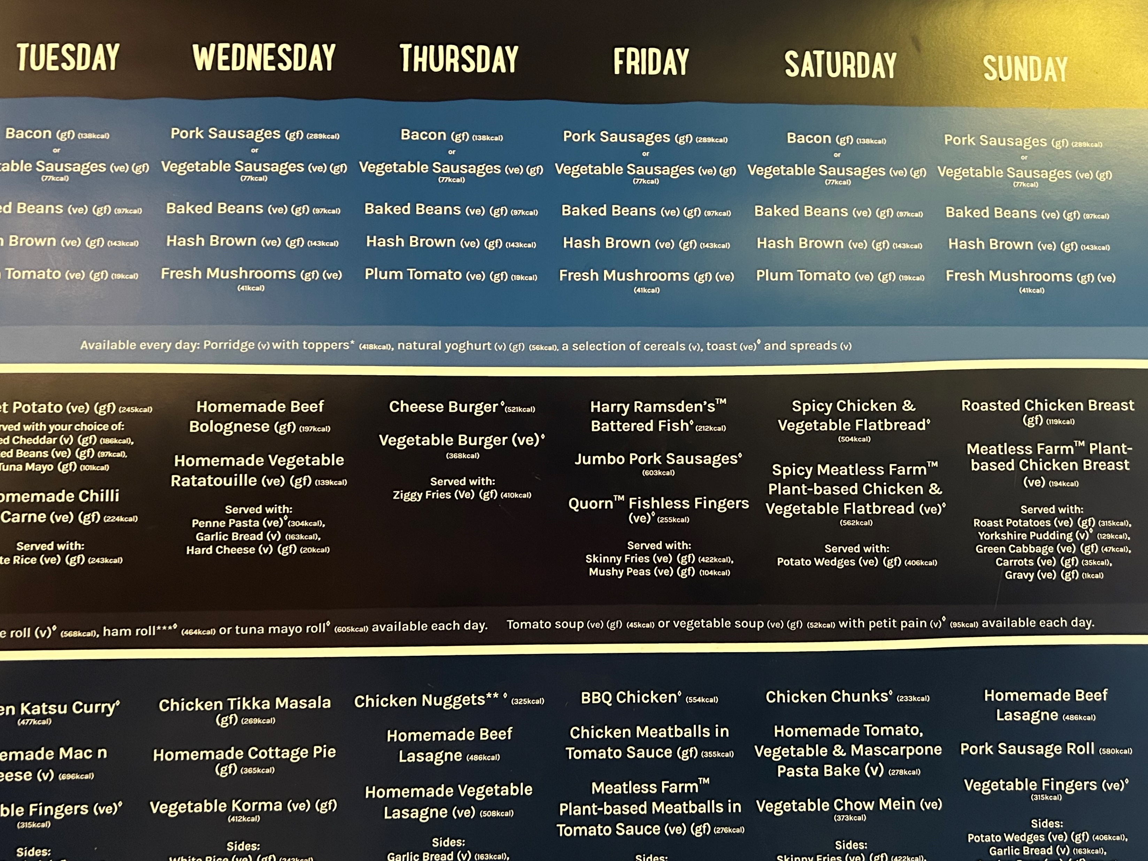

Slide 13
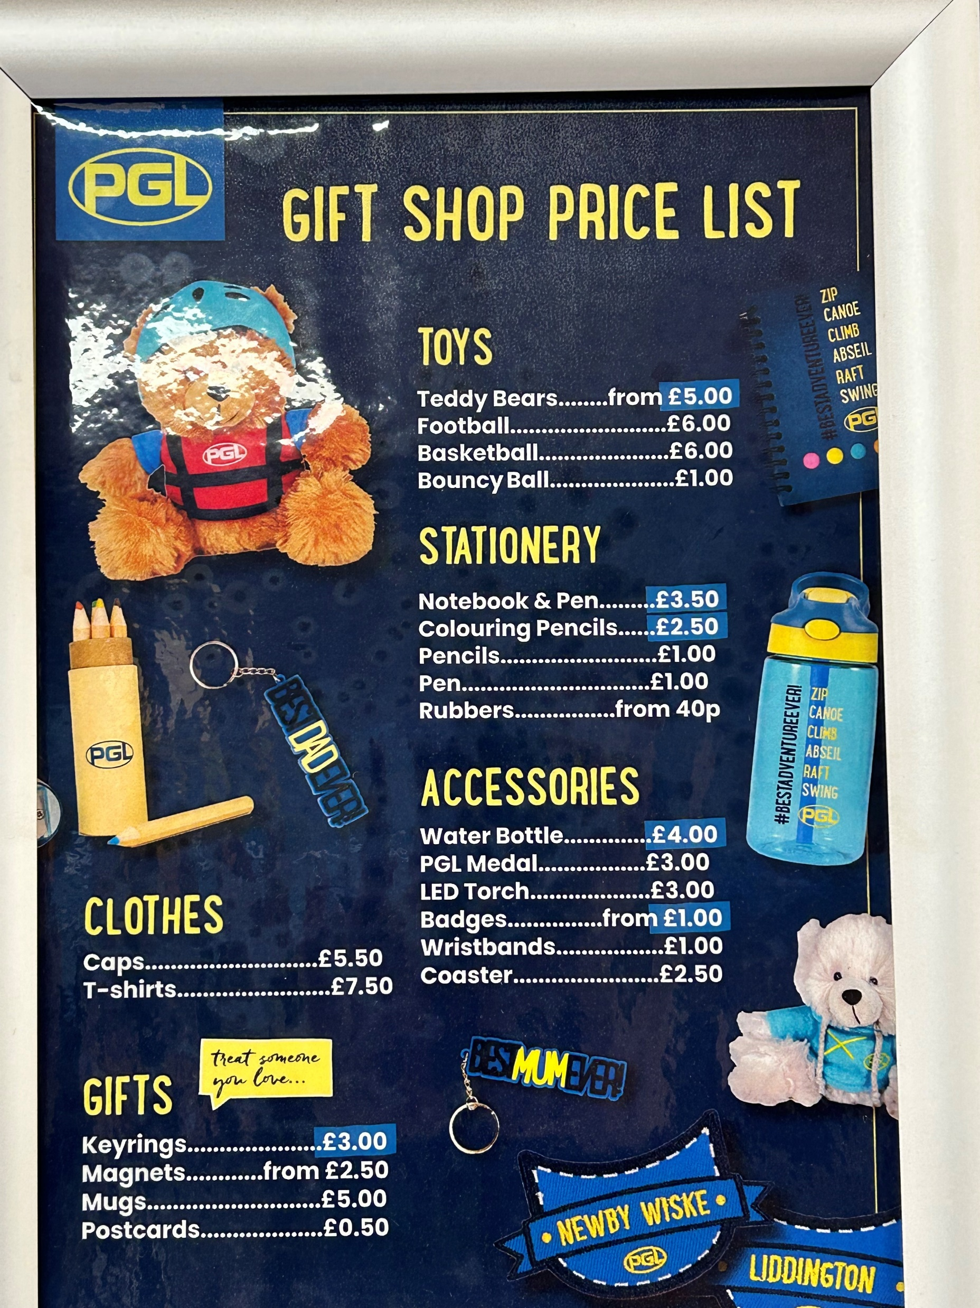
Money
There is a small shop on site which sell a range of souvenir items and sweets.
If your child would like to bring some money with them, please ensure it is no more than £10 in a named, sealed envelope. This will be passed to an adult on the morning of the trip to look after until our shop visit.

Slide 14
Medicine
Only medicines prescribed by the doctors (with all the appropriate labels on) and travel sickness medication will be administered to your child where necessary.
The label must have your child's name on with the appropriate dosage.
An adult will be in charge of giving medicines in the morning and evenings. Inhalers and medicine will be looked after by your child’s group leader. Please ensure these are in date.

Slide 15
Communication whilst at BVS.
BVS staff will be taking their own personal mobile phones and a school mobile phone to communicate with school and parents/ carers where necessary.
Whilst away, staff will also have access to their tablets to communicate via e-mail. Mrs Brodie-Shaw will answer these in the evening. If you have any queries whilst we’re away, please e-mail sweetpeas@bvs.ilf.education
Regular updates will be shared via a secure/locked Facebook group.
I am currently working with our IT expert in getting this set up and will share the details with you in due course.
Please complete the parental consent form and the photograph consent forms on the online form to indicate your preferences about sharing photographs taken during the residential if you have not already.

Slide 16
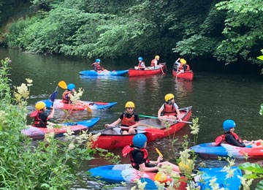
Behaviour expectations
We expect children to represent BVS to a high standard. If your child is not following the expectations set to keep themselves and others safe, you may be asked to come and collect your child.

Slide 17

Questions

